Slide 1

Humanalytics Empowering HR with Sentiment Analysis on Layoffs
University of Missouri–Kansas City
Ramya Thambabattula

Slide 2
Problem Statement
Amidst the prevalent layoffs and evolving workforce dynamics, how can we effectively navigate these complexities to cultivate resilience and promote sustainable employment practices that benefit both individuals and organizations?

Slide 3

INTRODUCTION
Integrating sentiment analysis into HR dashboard to understand employee reactions during layoffs. By analyzing feedback and social media posts, we gain insights into emotional impacts.
This aligns with our goal of improving user experience, promoting mobility, and ensuring compliance. Our AI-driven analytics provide actionable insights for proactive decision-making.

Slide 4

Objectives
Understanding the Human Impact: Layoffs in today's economy deeply affect individuals and organizations. Analyzing layoff stories unveils the emotional and social challenges faced by those impacted, providing crucial insights into the human side of job loss.
Identifying Trends and Patterns: Systematic analysis of layoff stories reveals recurring trends across industries and regions.
Evaluating Organizational Practices: The examination of layoff stories allows for an assessment of organizational responses, including communication strategies and support mechanisms.
Informing Strategic Decision-making: Insights from layoff story analysis empower policymakers, industry leaders, and HR professionals to develop effective strategies.

Slide 5
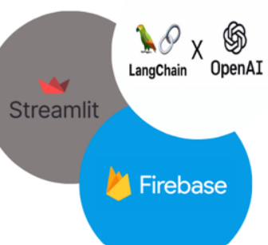
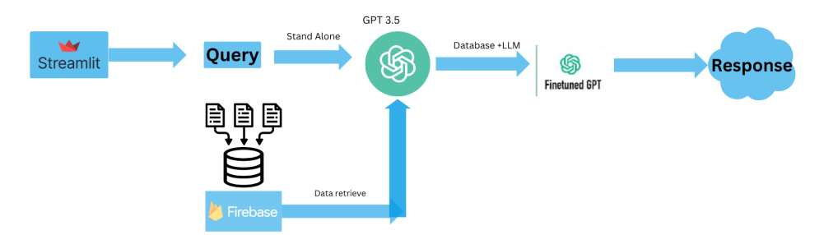
Methodology
Collect datasets: Reddit layoff stories, Twitter layoff stories, Kaggle layoff data, employee feedback, social media posts, textual data related to layoffs.
Utilize advanced AI techniques: Machine learning libraires and models for sentiment analysis.
Analyze textual data to extract sentiments and emotional responses regarding layoffs.
Model Integration: GPT-3.5, llm for intelligent data analysis and interpretation.

Slide 6

Dataset
Raw Data of Layoffs: This foundational dataset contains essential information regarding employee layoffs, including employee names, affected departments, layoff dates, and reasons for termination.
Raw Data from Employee Tweets: An unstructured dataset capturing employee feedback, sentiments, and perceptions related to HR activities through textual data from employee tweets.
Processed Data: The raw datasets undergo processing and transformation to prepare them for analysis and model training.
https://github.com/arslan719/Capstone_Project_5588/blob/main/Phase3.2/data_raw/layoffs_data.csv
https://github.com/arslan719/Capstone_Project_5588/blob/main/Phase3.2/data_raw/tweets.csv
https://github.com/arslan719/Capstone_Project_5588/blob/main/Phase3.2/data_raw/reddit_layoff.csv

Slide 7
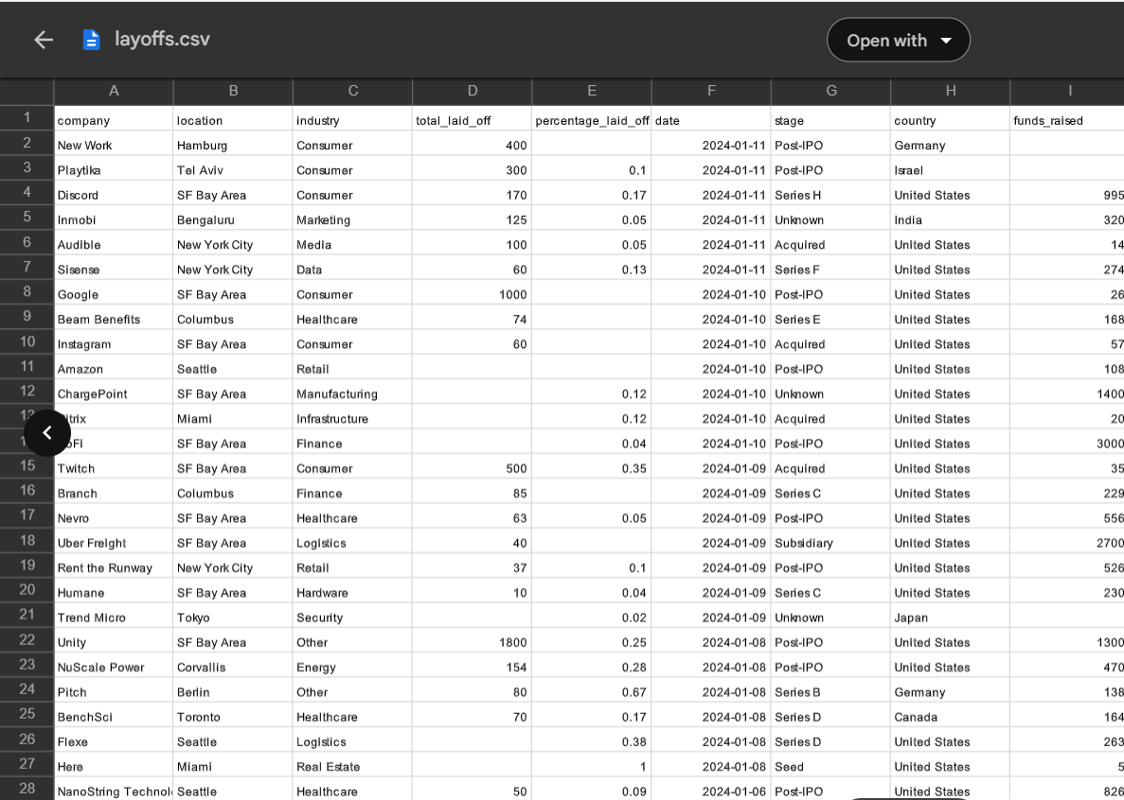
Raw Data of Layoffs
The core dataset contains comprehensive details of employee layoffs, including names, affected departments, termination dates, and reasons. By integrating this data with employee feedback and sentiment analysis, the dashboard offers HR professionals insights into emotional impacts, aiding informed decision-making during layoffs.

Slide 8
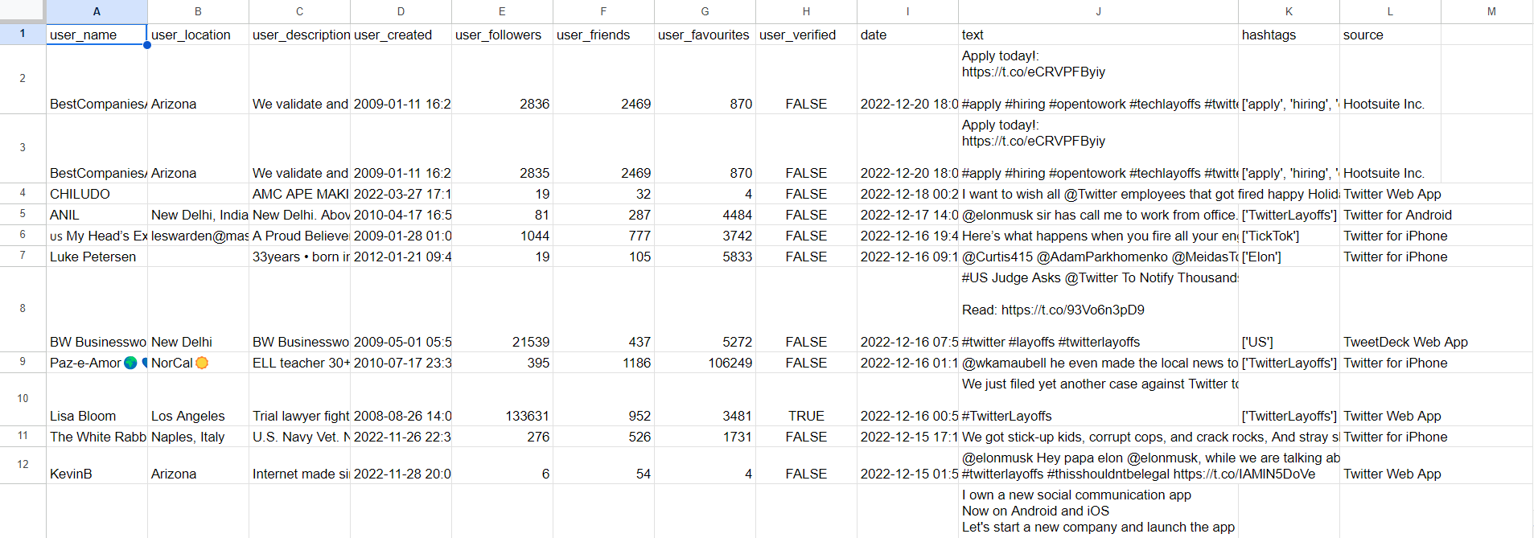
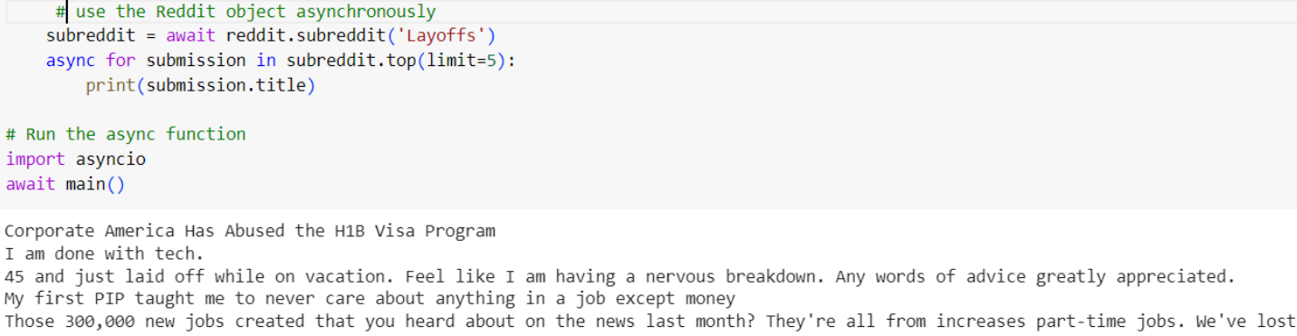
Raw Data from Employee Tweets
The raw data from employee tweets is an unstructured dataset containing textual data from employee tweets, capturing their feedback, sentiments, and perceptions related to various HR activities.

Slide 9
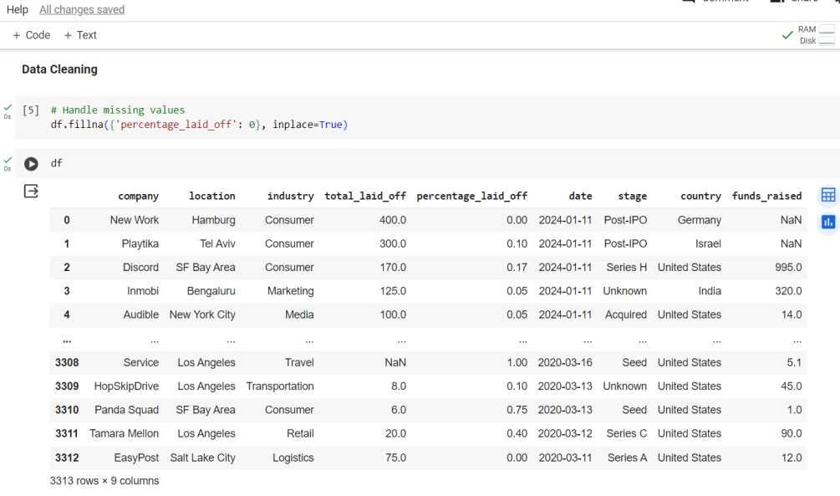
Data Cleaning

Slide 10
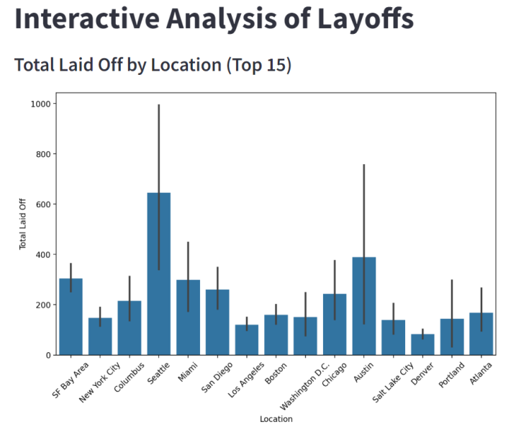
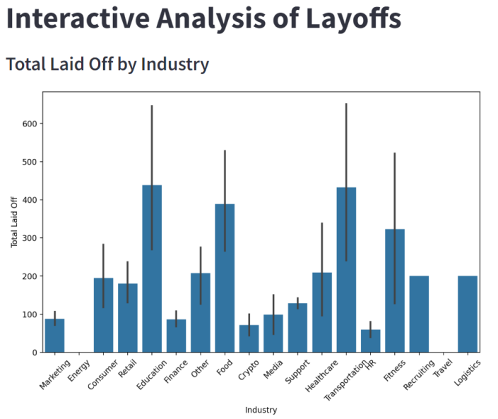
Visual representation of Layoffs Data
Figure 1
Figure 2

Slide 11
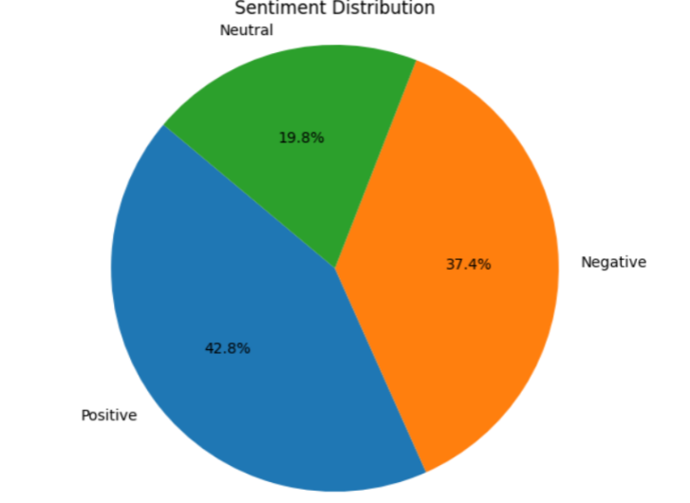
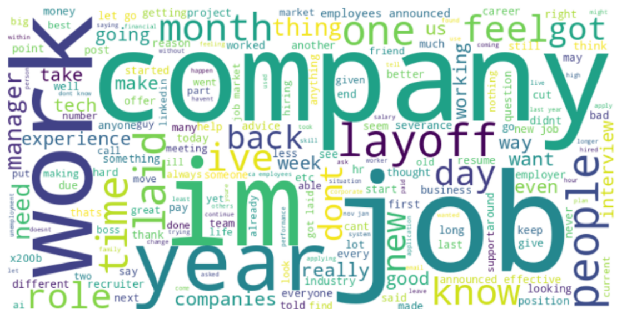
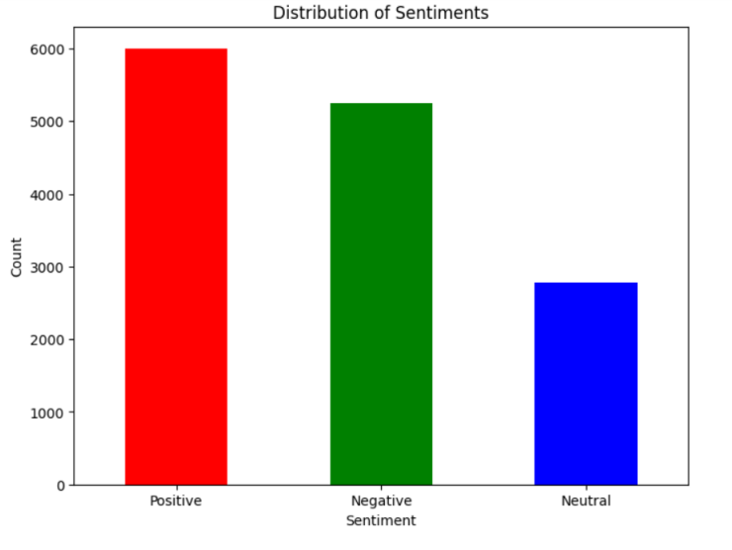
Sentiment Analysis of text Data

Slide 12
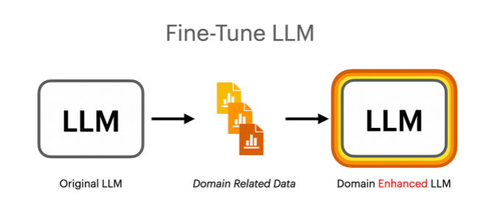
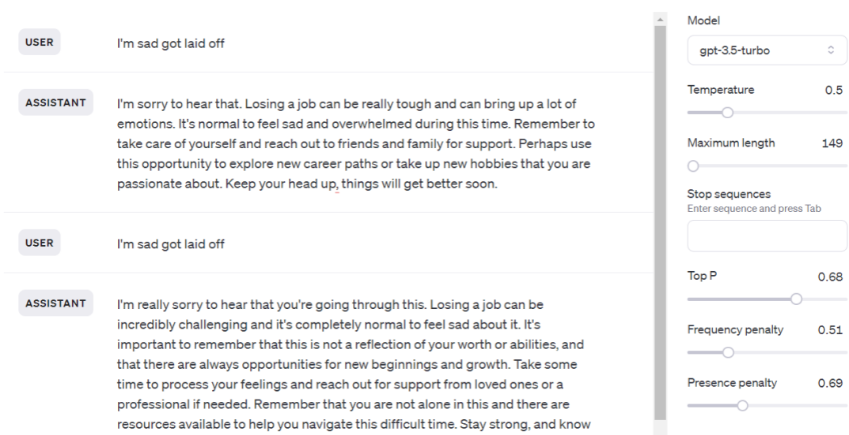
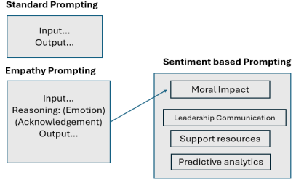
Fine tunning LLM

Slide 13
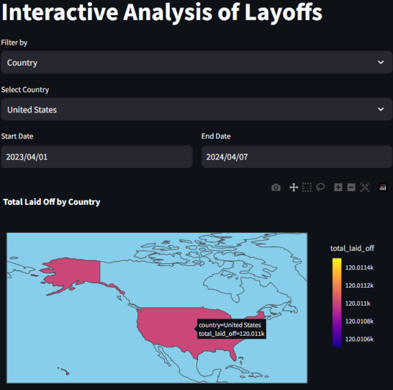
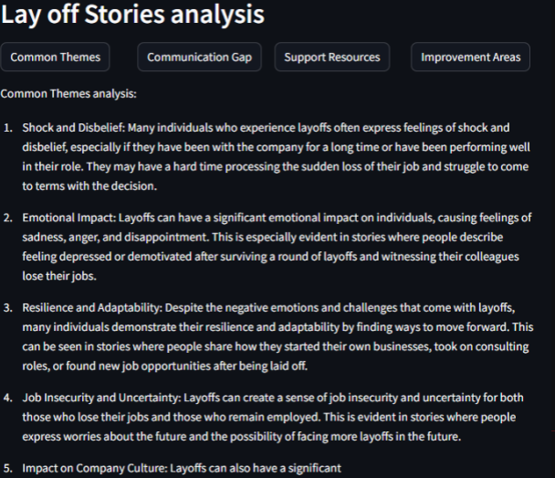
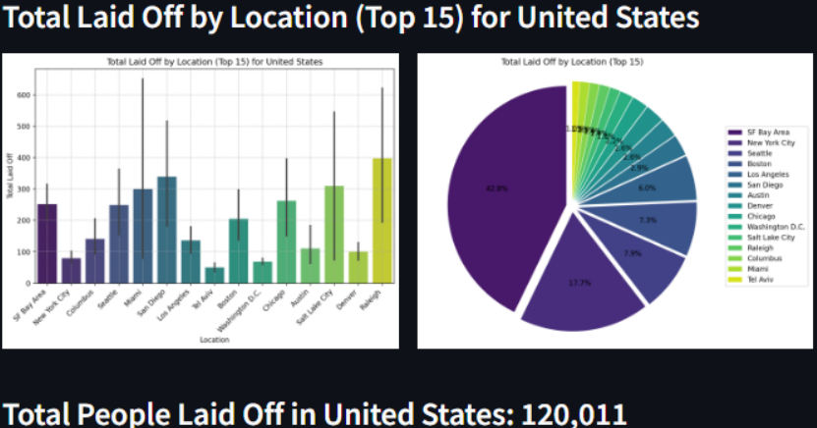
Streamlit Dashboard of Humanlytics

Slide 14
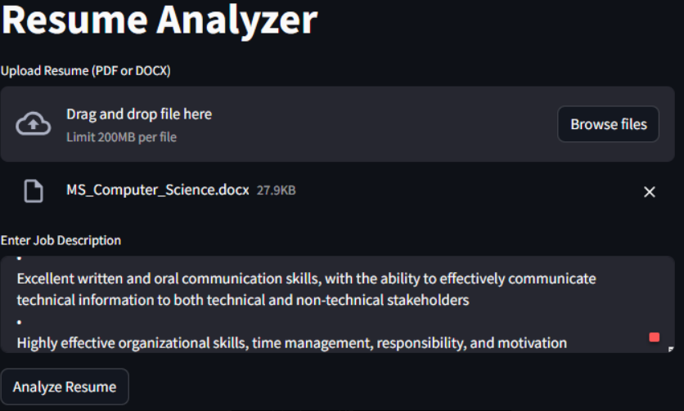
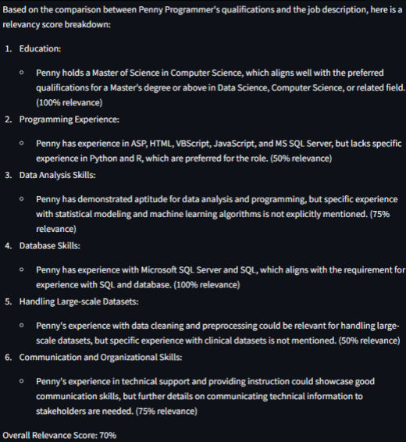
Resume Analysis

Slide 15
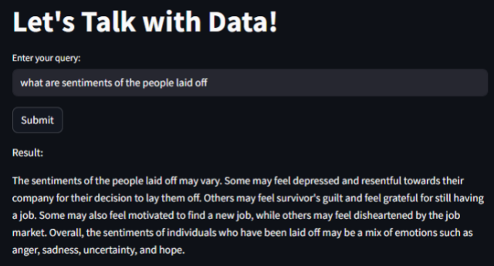
Q&A with data

Slide 16
Future Work
Collecting more data and refining the current capabilities of application.
Feature engineering and adding new feature empowering the llm to cater the HR.
Conduct continuous research for further analysis.

Slide 17
Conclusion
The HR Recruitment Prediction Dashboard revolutionizes HR practices by integrating frontend, backend, and AI components for instant insights. It optimizes recruitment procedures, enhances user experience, and prioritizes data security and compliance. Advanced features such as resume, and sentiment analysis further enrich its capabilities.

Slide 18
ReferenceS
[1] https://streamlit.io/
[2] https://colab.research.google.com/
[3] https://platform.openai.com/docs/models
[4] https://www.reddit.com/r/Layoffs/
[5] https://www.kaggle.com/datasets/theakhilb/layoffs-data-2022

Slide 19

THANK YOU

